Slide 1





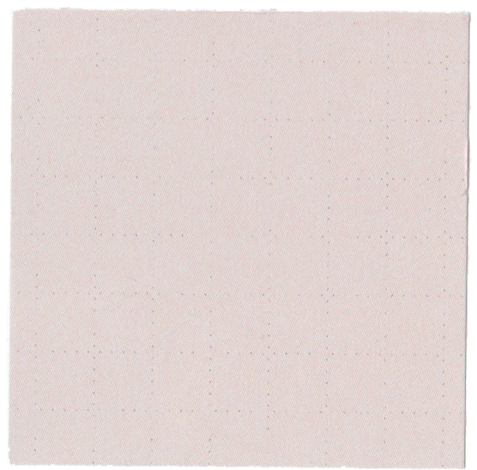





SEMESTER ASSIGNMENT
LET'S PLAY
TIC
TAC
TOE

Slide 2

CONTENTS
ProjectOverview
Class Diagram
Class Diagram Explained
Class Relationship

Slide 3
Create Xs and Os to the space of your choice.
Player 1
Player 2

Slide 4
Introduction: This CLI Tic-Tac-Toe project, developed in Java, showcasing implementation of Object-Oriented Programming (OOP) concepts. It features a OOP design comprising the Board class for managing game state, the Player class representing individual players, and the TicTacToe class showing game flow. Players interact via the CLI, making moves on the 3x3 grid until a win or tie condition is reached. The game adheres to OOP principles, encapsulating complex functionalities within appropriate classes and providing a user-friendly interface.
Project
Overview

Slide 5
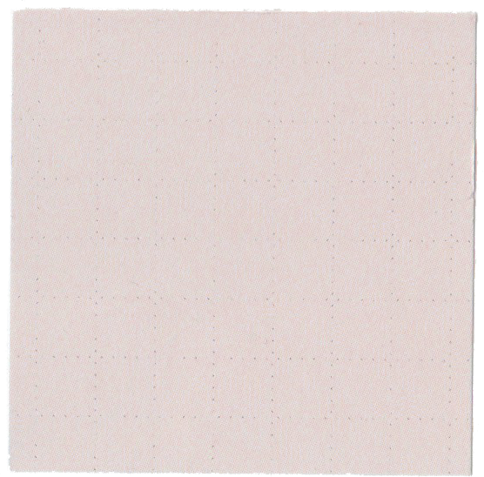
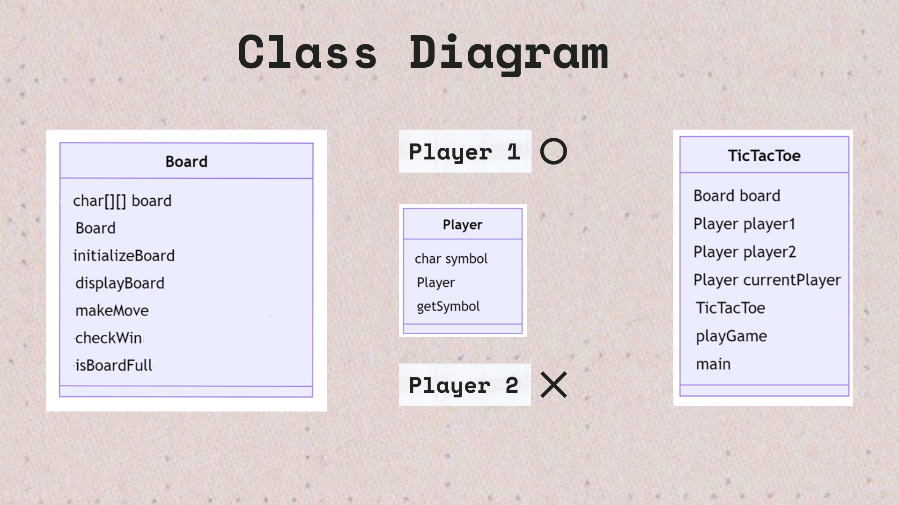

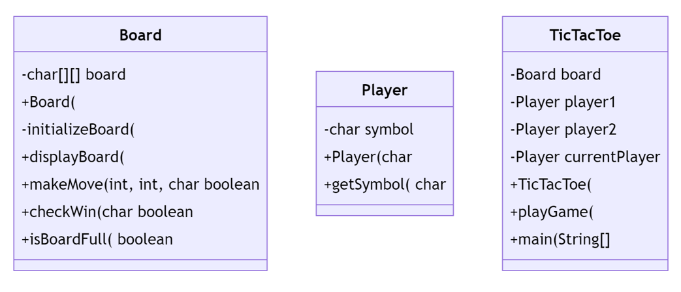
Class Diagram
Player 1
Player 2

Slide 6
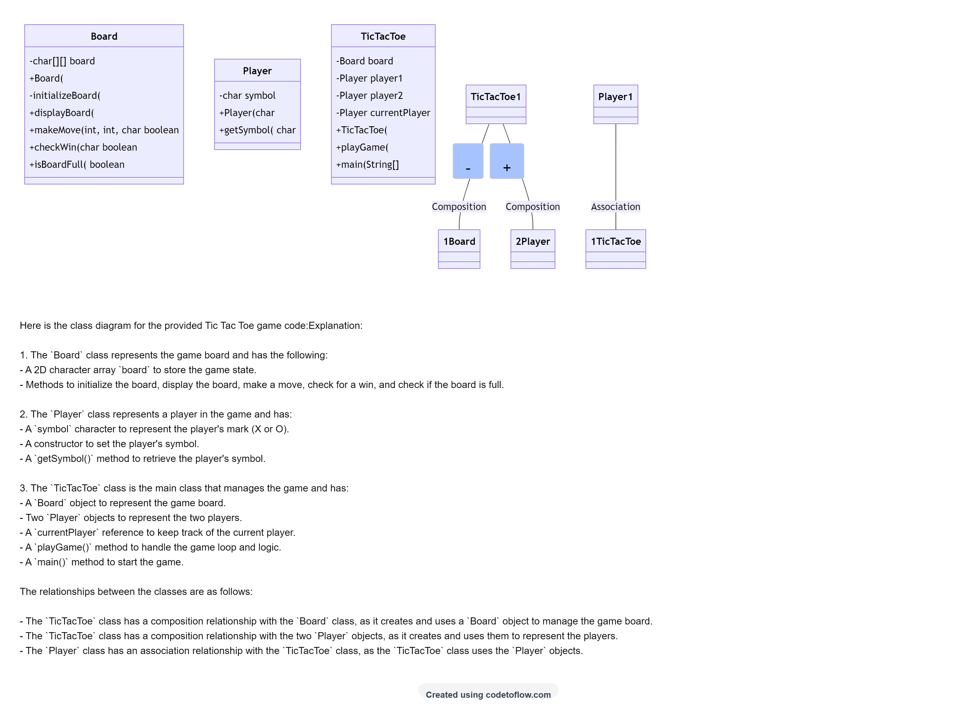
Class Diagram Explained

Slide 7
Class Relationship
The relationships between the classes are as follows: -
The Tic Tac Toe' class has a composition relationship with the Board class, as it creates and uses a 'Board' object to manage the game board.
The Tic Tac Toe class has a composition relationship with the two Player objects, as it creates and uses them to represent the players.
The Player class has an association relationship with the TicTacToe class, as the TicTacToe class uses the 'Player objects.

Slide 8

OUR TEAM
Shubham Karmveer
Pankaj Madaan
Aniket Chaurasia
523110049
523110031
523410021
Group-6
Group-4
Group-5

Slide 9

Thank you
for playing!

